Slide 1
Lecture - 16
Chapter 10
IMAGE SEGMENTATION

Slide 2


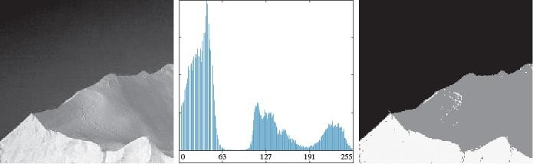
Multiple Thresholds

Slide 3
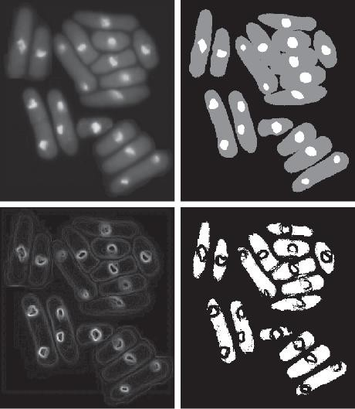
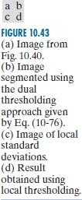



Variable Thresholding
using local image properties

Slide 4



Variable Thresholding
using moving averages

Slide 5


Variable Thresholding
using moving averages

Slide 6
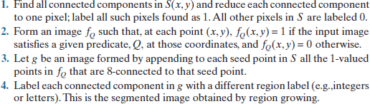

Region Growing

Slide 7
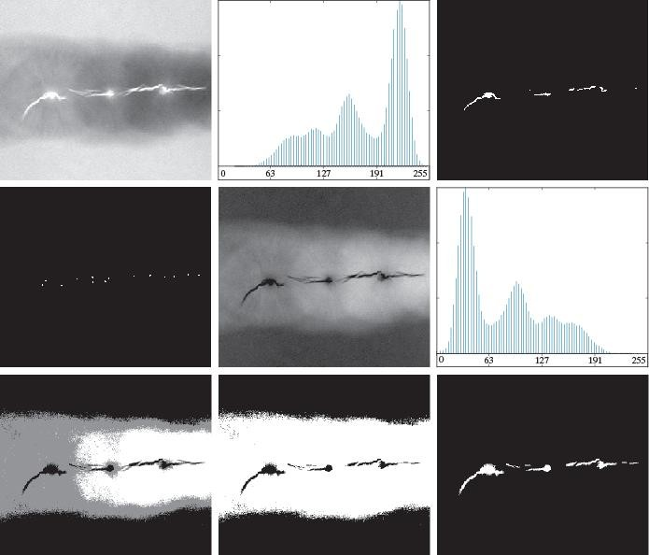
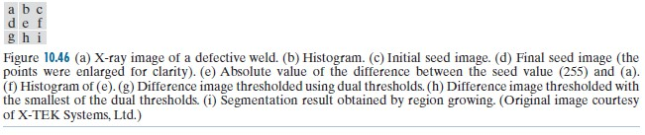
Region Growing

Slide 8

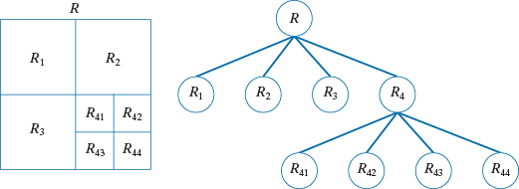
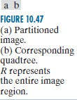
Region Splitting and Merging

Slide 9
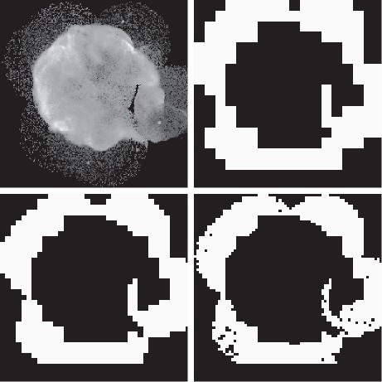
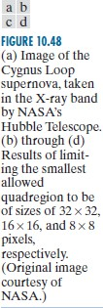
Region Splitting and Merging

Slide 10
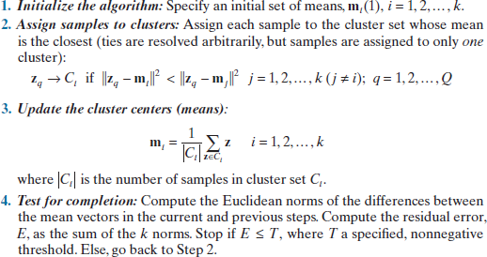

Region Segmentation using K-means Clustering

Slide 11

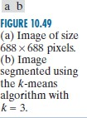
Region Segmentation using K-means Clustering

Slide 12
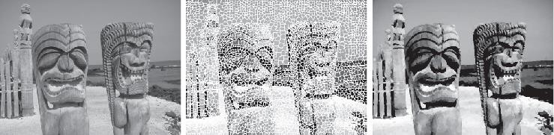

Region Segmentation using Superpixels

Slide 13
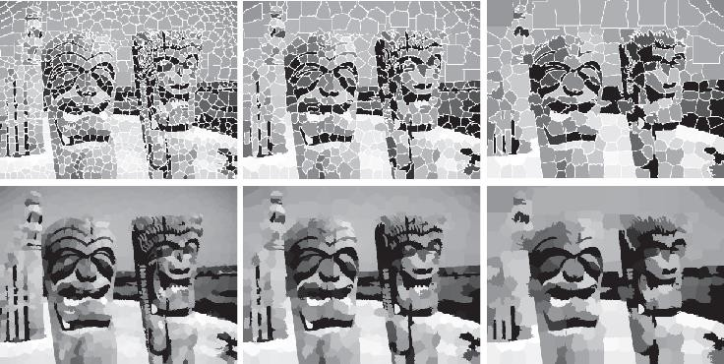
Region Segmentation using Superpixels

